Slide 1
Holiday Package Purchase Prediction
Olivia Lipari, Atharva Rotkar, Rishabh Sharma, Rachit Pandya, Arivunidhi Arivan

Slide 2
Problem Statement
Investigate and develop a predictive model to determine the likelihood of customer purchase for the newly introduced travel package. Identify the most significant variables influencing purchase behavior and recommend targeted strategies to effectively reach and engage with the most responsive customer segments

Slide 3
Problem Statement
Objectives:
Optimize marketing efforts
Reduce expenditure
Target potential customers effectively
Importance of findings:
Guide marketing team decisions
Tailor strategies to specific customer segments
Increase efficiency and effectiveness of marketing expenditure
Potential impact:
Cost efficiency
Targeted marketing
Competitive advantage
Business growth

Slide 4
Team Roles
Olivia- Primary: Deep data analysis Secondary: Tableau visualizations
Rishabh- Primary: Predictive modelling to identify potential buyers Secondary: Deep data analysis
Rachit- Primary: Data cleaning and integration process to prep data for analysis Secondary: Predictive modelling
Atharva- Primary: Tableau dashboards to visualize trends and insights Secondary: Data cleaning and integration
Ariv- Primary: Designing marketing strategies for customer segments Secondary: Ensuring accuracy of data
Avishkar- Primary: Ensuring accuracy of data Secondary: Designing marketing strategies for customer segments

Slide 5
Data
Source: Internal customer database of the company
Format: CSV (Comma-Separated Values)
Rows: To be determined after analyzing the dataset
Columns: Includes Designation, Passport, Tier City, Marital Status, Occupation, Monthly Income, Age, and Preferences for 5-star properties
Link: https://www.kaggle.com/datasets/susant4learning/holiday-package-purchase-prediction/data

Slide 6
Hypothesis
Based on preliminary analysis, we hypothesize that customers with specific characteristics (e.g., Executives, single/unmarried, from tier 3 cities, with passports, and interests in 5-star properties) are more likely to purchase the new Wellness Tourism Package.

Slide 7
Project Plan
Analysis Methodology: The team will conduct a comprehensive data analysis using Python for data cleaning, transformation, and modeling. We aim to identify key customer segments and predict potential buyers of the new package.
Data Visualization: Using Tableau, we will create visualizations to depict customer segments, purchase patterns, and other relevant insights to assist in decision-making.

Slide 8
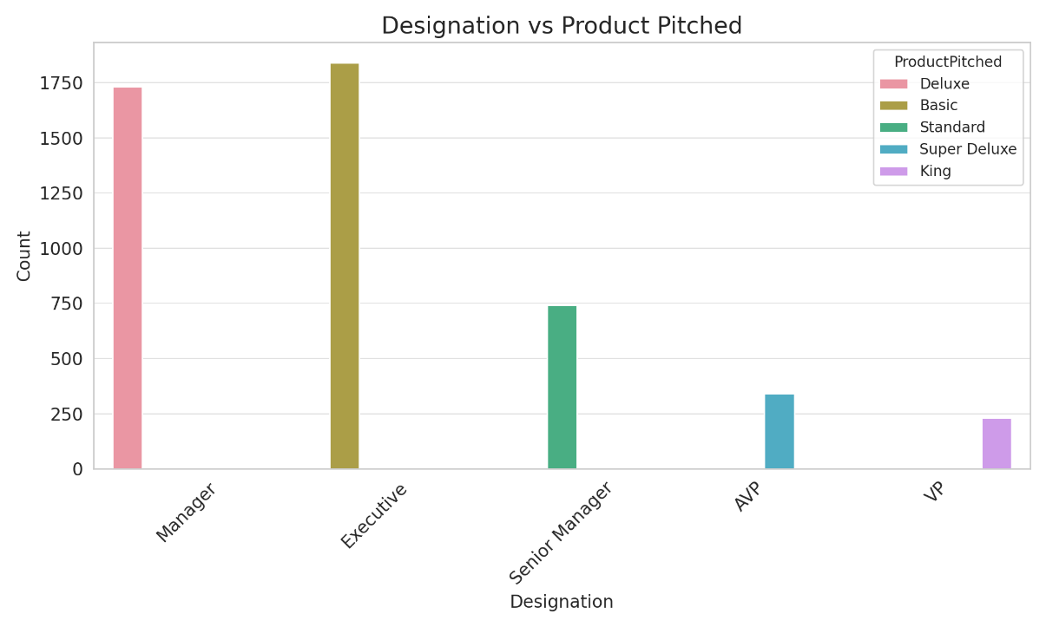
Exploratory Work
Different designations show varying levels of product purchase. This suggests that certain professional levels may be more inclined to purchase travel packages, with specific designations potentially being key targets for the new Wellness Tourism Package.

Slide 9
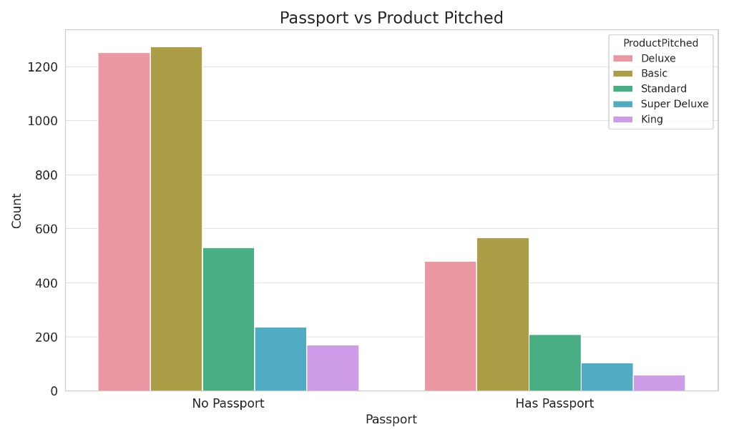
Customers with passports are more likely to have purchased a package compared to those without, indicating that having a passport might be a strong predictor of interest in travel packages.

Slide 10
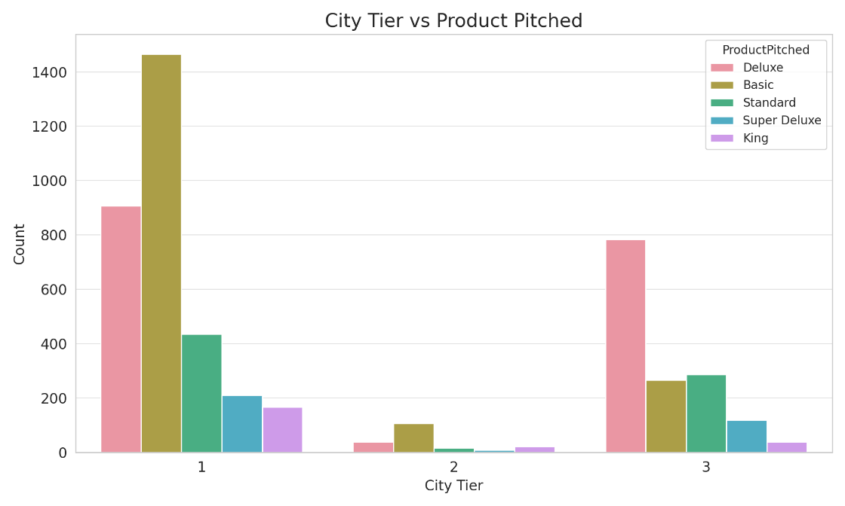
There is a variation in product purchase across city tiers, suggesting that the city's tier could influence travel package purchases.

Slide 11
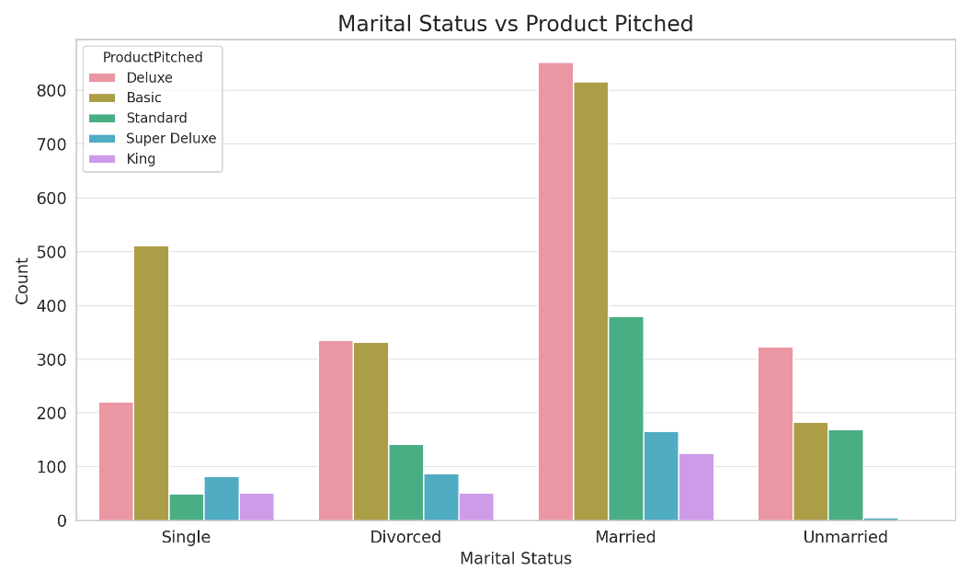
Marital status appears to influence the likelihood of purchasing a travel package, with differences observed between single, married, and other statuses.

Slide 12
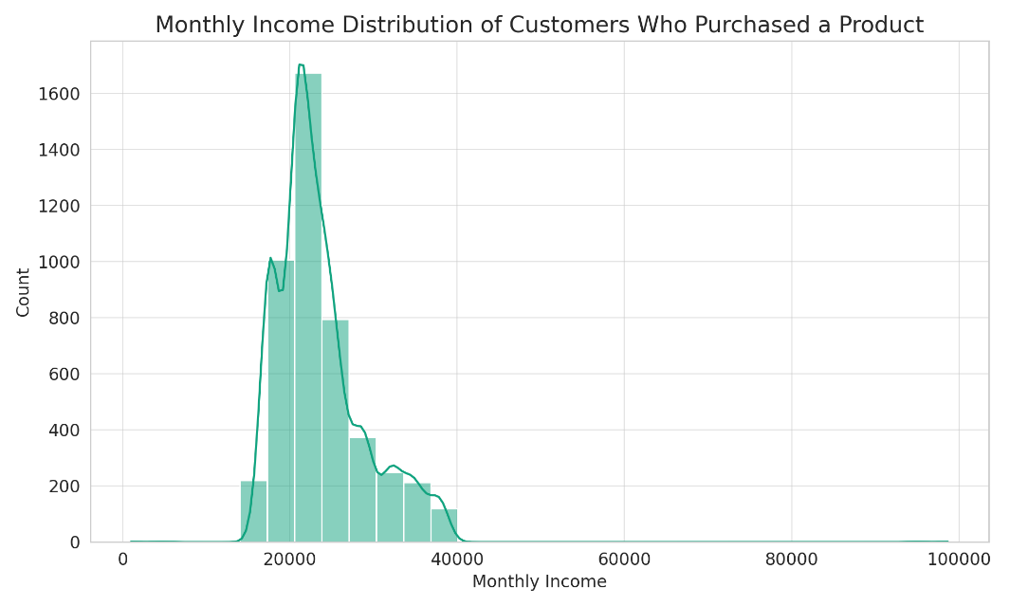
The distribution of monthly income among customers who have purchased a package shows that certain income ranges might be more predisposed to purchasing travel packages.

